Slide 1
Coursera Capstone
IBM Applied Data Science Capstone Opening a New Bakery in Dubai, United Arab Emirates By: Muhammad Bilal, Jan 2020.

Slide 2
Business Problem
The objective of this capstone project is to analyse and select the best locations in the city of Dubai, UAE to open a new Bakery. Using data science methodology and machine learning techniques like clustering, this project aims to provide solutions to answer the business question: In the city of Dubai, UAE, if a property developer is looking to open a new Bakery, where would you recommend that they open it?

Slide 3
Data To solve the problem
we will need the following data:
• List of neighborhoods in Dubai:
This defines the scope of this project which is confined to the city of Dubai, the capital city of the country of UAE in South East Asia.
• Latitude and longitude coordinates of those neighborhoods:
This is required in order to plot the map and also to get the venue data.
•Venue data, particularly data related to Bakerys:
We will use this data to perform clustering on the neighborhoods.

Slide 4
Sources of data and methods to extract them
This Wikipedia page (https://en.wikipedia.org/wiki/Category:Suburbs_in_Dubai) contains a list of neighborhoods in Dubai, with a total of 70 neighborhoods. We will use web scraping techniques to extract the data from the Wikipedia page, with the help of Python requests and beautifulsoup packages. Then we will get the geographical coordinates of the neighborhoods using Python Geocoder package which will give us the latitude and longitude coordinates of the neighborhoods. After that, we will use Foursquare API to get the venue data for those neighborhoods. Foursquare has one of the largest database of 105+ million places and is used by over 125,000 developers. Foursquare API will provide many categories of the venue data, we are particularly interested in the Bakery category in order to help us to solve the business problem put forward. This is a project that will make use of many data science skills, from web scraping (Wikipedia), working with API (Foursquare), data cleaning, data wrangling, to machine learning (K-means clustering) and map visualization (Folium). In the next section, we will present the Methodology section where we will discuss the steps taken in this project, the data analysis that we did and the machine learning technique that was used.

Slide 5
Results
The results from the k-means clustering show that we can categorize the neighborhoods into 3 clusters based on the frequency of occurrence for “Bakery”:
• Cluster 1: Neighborhoods with moderate number of Bakerys
• Cluster 2: Neighborhoods with low number to no existence of Bakerys
• Cluster 0: Neighborhoods with high concentration of Bakerys.

Slide 6
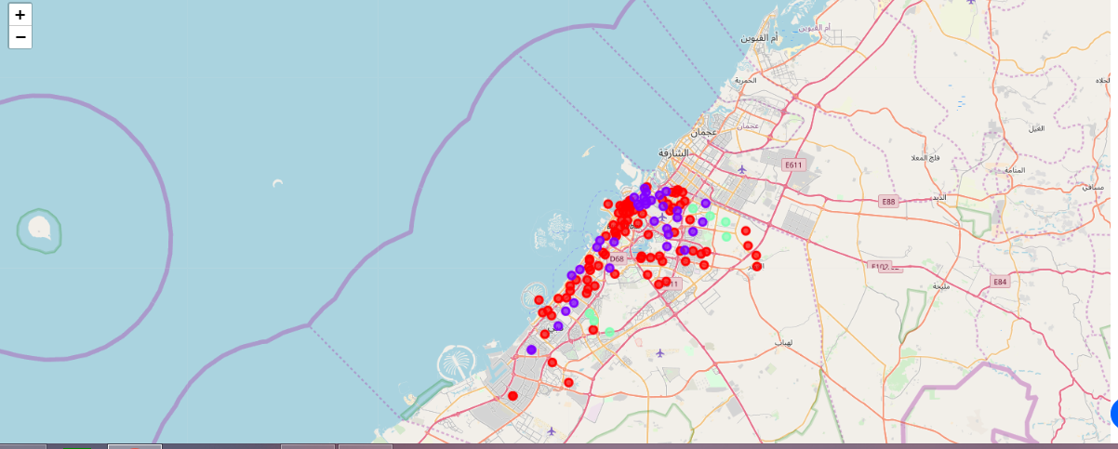

Slide 7
Conclusion
In this project, we have gone through the process of identifying the business problem, specifying the data required, extracting and preparing the data, performing machine learning by clustering the data into 3 clusters based on their similarities, and lastly providing recommendations to the relevant stakeholders i.e. property developers and investors regarding the best locations to open a new Bakery. To answer the business question that was raised in the introduction section, the answer proposed by this project is: The neighborhoods in cluster 1 are the most preferred locations to open a new Bakery. The findings of this project will help the relevant stakeholders to capitalize on the opportunities on high potential locations while avoiding overcrowded areas in their decisions to open a new Bakery.

